Slide 1
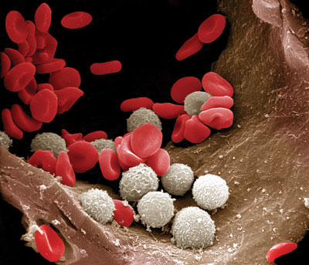
Leukocytes
WBC Morphology
Clinical Pathology
VTHT 2323
Lori VanValkenburg, RVT

Slide 2
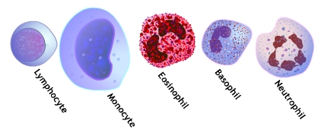
Classified as Granulocytes or Agranulocytes
Granulocytes
(WBCs that contain microscopic granules)
  Neutrophil
  Eosinophil
  Basophil
Agranulocytes
(WBCs that contain no microscopic granules)
  Lymphocyte
  Monocyte

Slide 3
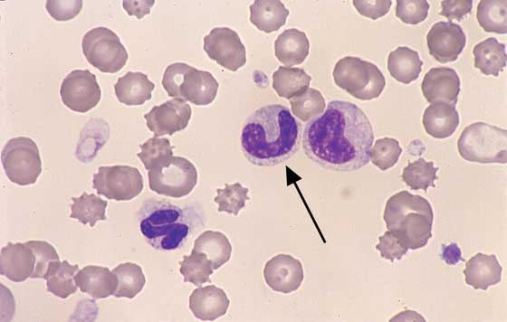
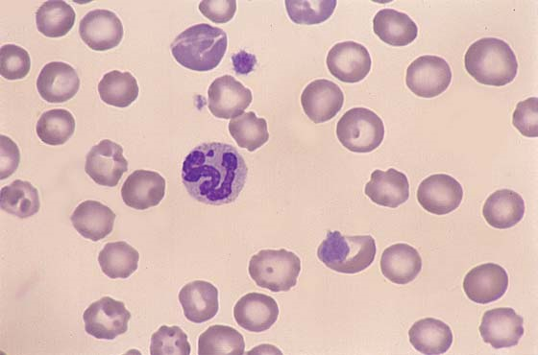
Granulocyte Morphology: Neutrophils
  Neutrophils
    Cytoplasm stains pale pink with fine, diffuse granules
    Nucleus is irregular and elongated (3-5 lobes = avg. = “segmented neutrophil”); nuclear chromatin appears coarsely clumped
    Band = younger; nucleus is horseshoe shaped
    Hyper-segmented = very mature; multilobed nucleus (>5 lobes)
    Classification is somewhat subjective; if in doubt, best to classify as a “segmented neutrophil”
Canine neutrophil with Barr body. The small tennis racket shaped appendage on the neutrophil nucleus is a Barr body, or sex lobe, indicating that the dog is a female. This can be a useful morphologic feature in dogs and cats if there is a question of gender or patient identity
Immature neutrophils. A band (arrow) and metameclocyte are located in the center. A normal segmented neutrophil is located in the lower left

Slide 4
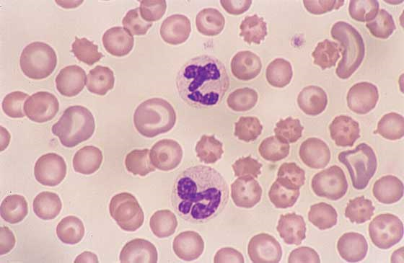
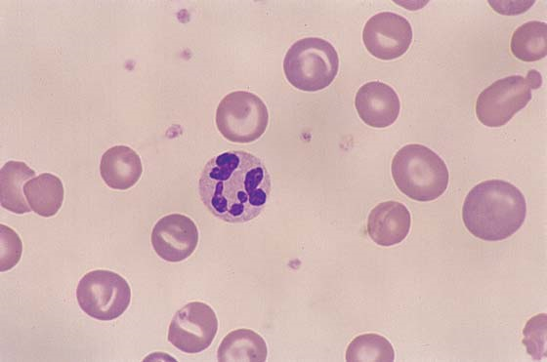
Neutrophil Morphology
Normal, “Segmented neutrophils”
Hypersegmented neutrophil
Normal canine neutrophils. Both neutrophils have a lobulated nucleus in a light pink finely granulated cytoplasm
Hypersegmented neutrophil. Dog and cat neutrophils may have up to five nuclear lobes. This neutrophil has 8 nuclear lobes and is evidence of prolonged lifespan

Slide 5
Toxic Changes in Neutrophils
Disease-induced cytoplasmic changes
Thought to be caused by decreased time of neutrophil maturation within bone marrow.
Associated with inflammation, infection, and drug toxicity
Seen commonly in cats that are not severely ill.
Changes are more significant in dogs
Severe = suggestive of bacterial infection

Slide 6
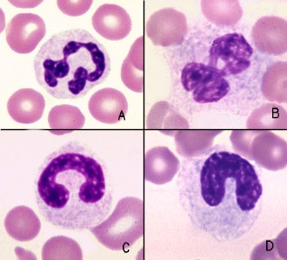
Toxic Changes in Neutrophils
Normally matured segmented and late band neutrophils, shown in panels A and C, have white cytoplasm with pink granules, long and fairly narrow nuclei and tightly condensed chromatin.
Segmented and band neutrophils with toxic change (examples shown in panels B and D) have less condensed chromatin than their normal counterparts and bluer cytoplasm due to retention of ribosomal RNA. The cytoplasmic basophilia can be focal, streaked, or diffuse.
A: Normal, segmented neutrophil
B: Toxic segmented neutrophil
C: Normal, band neutrophil
D: Toxic band neutrophil

Slide 7
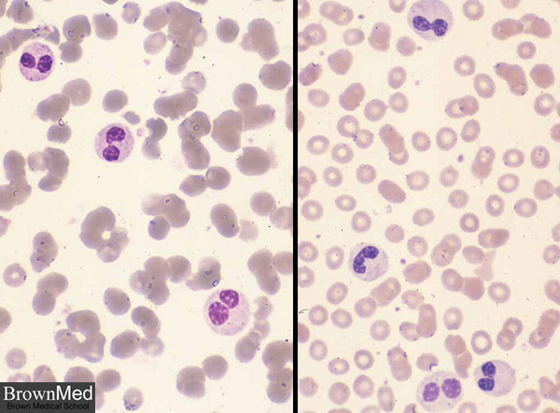
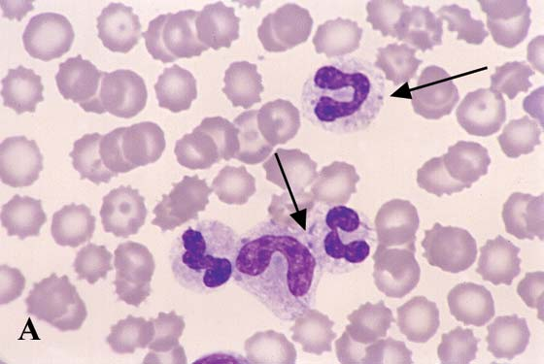
Abnormal Neutrophil Morphology
Pelger-Huet Anomaly
Dohle Bodies
This inherited disorder causes hyposegmentation of neutrophil and eosinophil nuclei, giving the appearance of a persistent left shift. However, the neutrophils do not have toxic change and the nuclear chromatin is very dark and condensed indicating maturity
Blue cytoplasmic inclusions.
Low numbers may be found in healthy cats.
Indicates toxicity in other species.

Slide 8
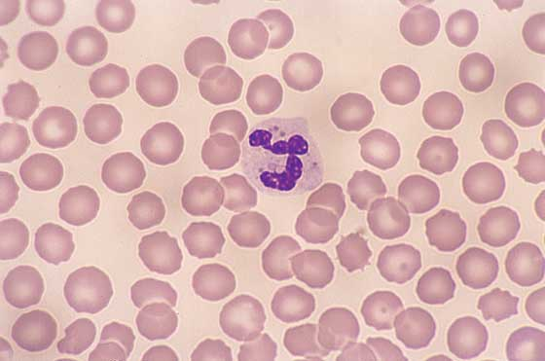
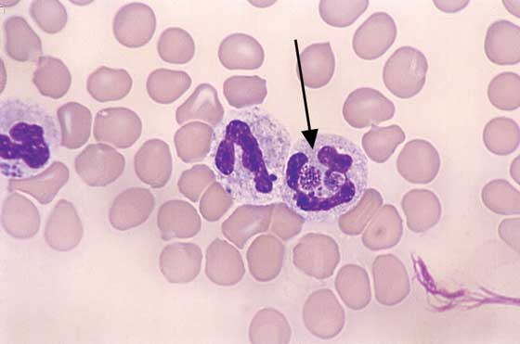
Neutrophil Inclusions in Infectious Disease
Canine Distemper inclusions
Canine Ehrlichia
Other organisms that can be found in the cytoplasm of neutrophils include Ehrlichia, Hepatozoon, & Histoplasma.
May appear in RBCs or neutrophils
Pale light pink, round cytoplasmic droplets in the neutrophil are canine distemper viral inclusions
Round, granular, basophilic inclusion in neutrophil cytoplasm (arrow) is an Ehrlichia morula

Slide 9
Granulocyte Morphology: Eosinophils
  Eosinophils
    Colorless to pale blue cytoplasm
    Granules stain distinctively reddish-orange and vary in morphologic appearance from species to species
        Canine = round, vary in size, less numerous than in cats
          Greyhounds often have eosinophils that are degranulated and appear vacuolated
        Feline = rod-shaped, >numerous than in dogs; may obscure nucleus
        Equine = round, very large, brighter orange than dogs and cats
    Nucleus is irregular and elongated; similar to that of the neutrophil, but chromatin is not as coarsely clumped

Slide 10
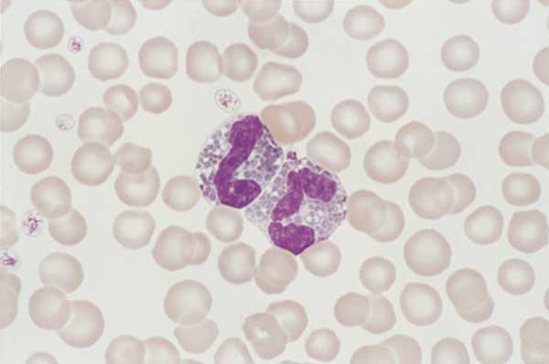
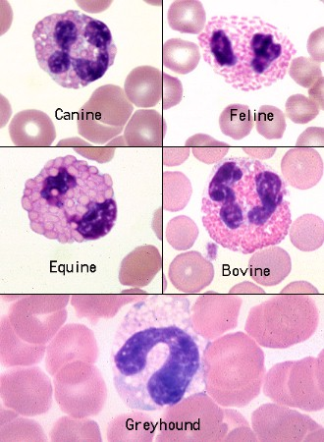
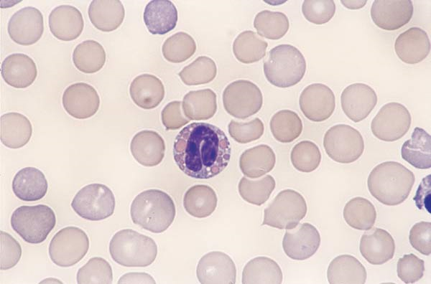
Eosinophil Morphology

Slide 11
Granulocyte Morphology: Basophils
  Basophils
    Cytoplasm stains grey-blue
    Classically, granules stain dark blue/purple but may vary considerably from species to species
      Canine: few to no granules; must be differentiated from neutrophils on the basis of an elongated nucleus and a more basophilic cytoplasm.
      Feline: light lavender to almost pink granules
    Nucleus is segmented (elongated and lobulated); resembles nucleus of a monocyte
      Chromatin is more diffuse than that of a neutrophil
    Larger in diameter than neutrophils
    Frequently confused with mast cells because of similar granules
      Mast cell: a cell of monocytic origin that lives in the connective tissue around vessels and plays an important role in hypersensitivity reactions. It has a round or oval nucleus and contains histamine and heparin granules.

Slide 12
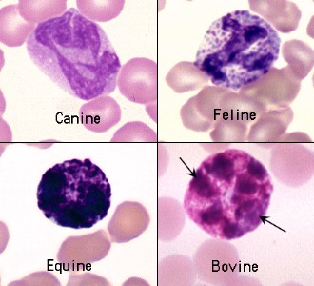
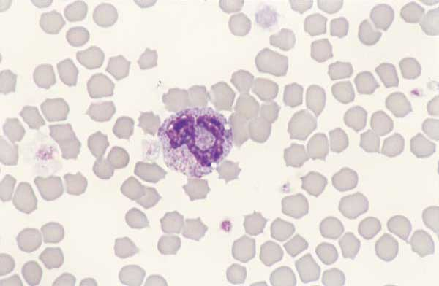
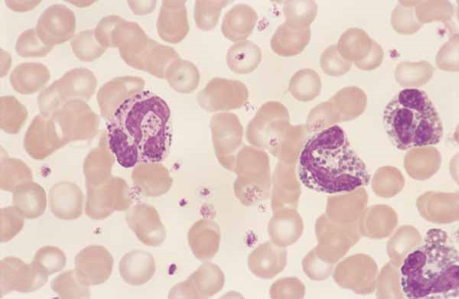
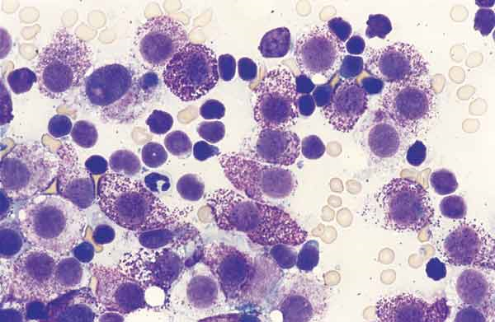
Basopil Morphology
Feline basophil
Basophils
Canine basophils
Mast cells in fine needle aspirate of lymph node

Slide 13
Agranulocyte Morphology: Lymphocytes
  Lymphocytes
    Typically round, larger than neutrophil; vary in size from small to large
    Thin rim of light to dark blue cytoplasm may appear to contain blue granulation
    Nucleus is relatively large (occupies most of the cytoplasm), rounded, and often eccentric; stains deep purple with dense chromatin
    Large lymphocytes: common in cattle; atypical in cats/dogs and may be related to either infectious or neoplastic disease
    Reactive lymphocytes: Have extremely basophilic cytoplasm with pale perinuclear zone (the site of the Golgi apparatus) and blue granules; possible vacuolation. These are seen in blood during periods of antigenic stimulation.
  Note: The different sub-types of lymphocytes cannot be differentiated using the traditional microscopy equipment and techniques employed by most vet practices.

Slide 14
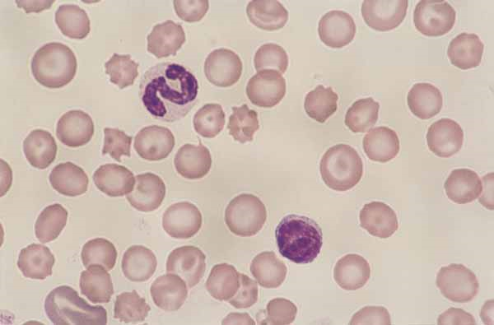
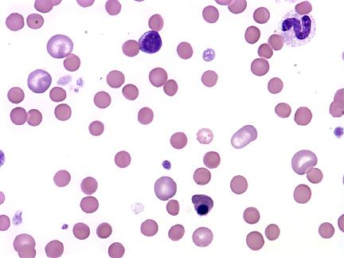
Normal Lymphocyte Morphology
Normal lymphocytes. Lymphocytes in the dog and cat are the same size or smaller than a neutrophil. Canine lymphocytes have a scant amount of light blue cytoplasm with an eccentric, round, nucleus that has a dark, smooth chromatin.
Immune Mediated Hemolytic Anemia: Normal Lymphocyte, Metarubricyte (NRBC) , Reticulocytes, Neutrophil (Canine)

Slide 15
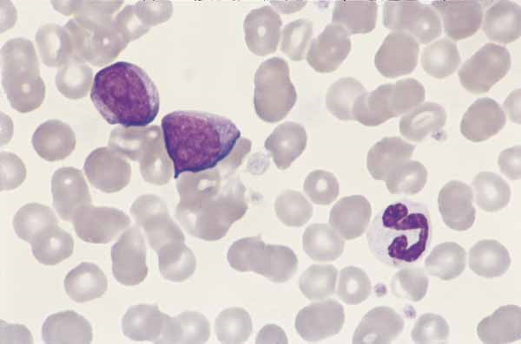
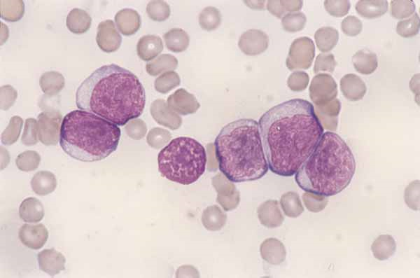
Abnormal Lymphocyte Morphology
Reactive lymphocytes
Atypical (large) lymphocytes
a.k.a. “Activated lymphocytes” - Antigenic stimulation produces morphologic changes in canine lymphocytes. Reactive lymphocytes are larger than a neutrophil, vary in size, and have dark blue cytoplasm. Nuclei are rounded with a reticular chromatin and remnants of nucleoli
Canine lymphocytic leukemia. Numerous large lymphocytes are noted that have an abundant light blue cytoplasm, reticulated chromatin, and prominent nucleoli

Slide 16
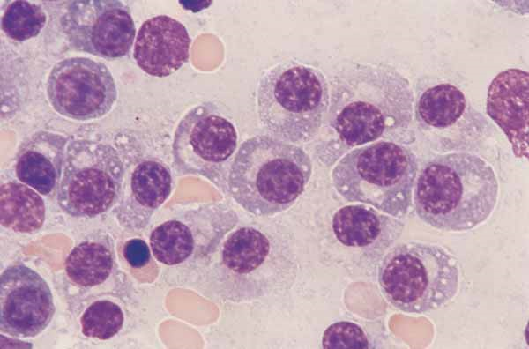
Lymphocyte Morphology: Plasma Cells
Plasma cells are differentiated lymphocytes that produce large amounts of immunoglobin and are similar in size to neutrophils. They have a distinctively round nucleus and usually appear to have abundant cytoplasm.
Plasma cells. B lymphocytes differentiate into plasma cells. These cells have an eccentric round nucleus, clumped chromatin, and blue cytoplasm that contains a focal clear zone

Slide 17
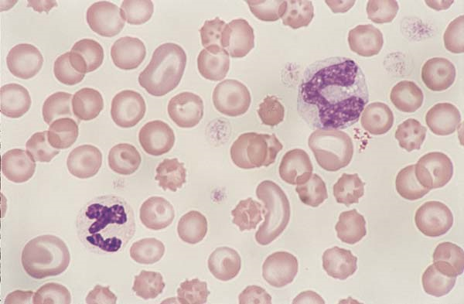
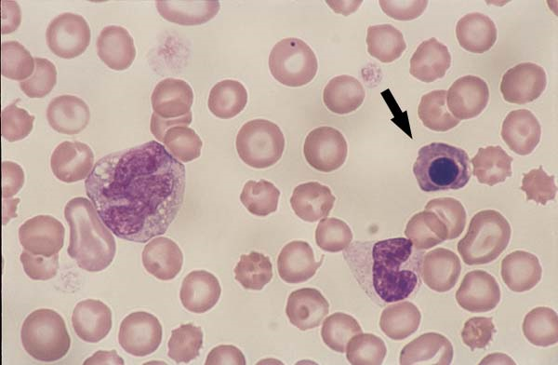
Agranulocyte Morphology: Monocytes
  Monocytes
    Largest of the peripheral WBCs
    Gray-blue, often grainy, cytoplasm; usually vacuolated; fine, pink granules may be present
    Nucleus can be round, oval, ameboid, or lobulated; chromatin is diffuse and not as intensely stained
    Most common problem with identification is the tendency to confuse monocytes (having a bean-shaped nucleus) with a band neutrophil. Remember that the cytoplasm is usually darker blue than that of a band neutrophil.

Slide 18
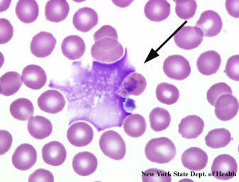
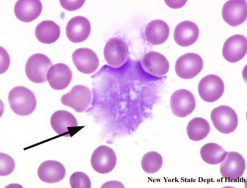
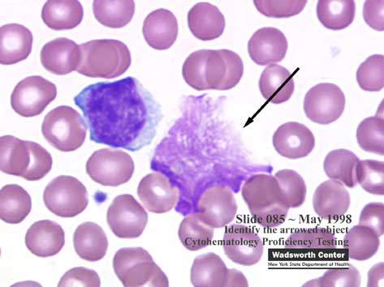
Smudge Cells “Basket Cells”
Degenerative leukocytes that have ruptured
Presence in blood film not considered significant unless large numbers are present
  Small number of smudge cells may be artifact
  Blood held too long before making smear
  Excess pressure applied to spreader slide
Large numbers = may be associated with leukemia

Slide 19

Basic Terminology
Leukocytes = white blood cells = WBCs
  “-penia” or “-cytopenia” (deficiency)
  “-philia” or “-cytosis” (“affinity for”)
    Ex: lymphopenia, lymphocytosis, eosinopenia, eosinophilia, basopenia, basophilia, monocytopenia, monocytosis neutropenia, neutrophilia
Leukopenia
  Reduction in circulating WBCs
  Almost always due to neutropenia
Leukocytosis
  Increase in circulating WBCs
  Most often result of neutrophilia

Slide 20
WBC Terminology
Left shift: increased numbers of immature (band neutrophils) in the blood.
Right shift: increased number of hypersegmented neutrophils in circulation
Leukemia: neoplastic cells in the blood or bone marrow. (neoplasia = any new and abnormal growth, specifically one in which cell multiplication is uncontrolled and progressive)
Leukemoid response: marked leukocytosis (>50,000/ul) usually a result of inflammatory disease.

